Slide 1
Algorithms For Inverse Reinforcement Learning
Presented by
Alp Sardağ

Slide 2

Goal
Given the observed optimal behaviour extract a reward function. It may be useful:
  In apprenticeship learning
  For ascertaining the reward function being optimized by a natural system.

Slide 3
The problem
Given:
  Measurements of an agent’s behaviour over time, in a variety of circumstances.
  Measurements of the sensory inputs to that agent.
  İf available, a model of the environment.
Determine the reward function.

Slide 4
Sources of Motivation
The use of reinforcement learning and related methods as computaional models for animal and human learning.
The task of of constructing an intelligent agent that can behave successfully in a particular domain.

Slide 5

First Motivation
Reinforcement learning:
  Suported by behavioral studies and neurophysiological evidence that reinfocement learning occurs.
  Assumption: the reward function is fixed and known.
  In animal and human behaviour the reward function is an unknown to be ascertained through emperical investigation.
  Example:
    Bee foraging: the litteratture assumes reward is the simple saturating function of nectar content. The bee might weigh nectar ingestion against flight distance, time and risk from wind and predators.

Slide 6
Second Motivation
The task of constructing an intelligent agent.
  An agent designer may have a rough idea of reward function.
  The entire field of reinforcement is founded on the assumption that the reward function is the most robust and transferrable definition of the task.

Slide 7


Notation
A (finite) MDP is a tuple (S,A,{P_{sa}},γ,R) where
  S is a finite set of N states.
  A={a₁,...,a_{k}} is a set of k actions.
  P_{sa}(.) are the state transition probabilities upon taking action a in state s.
  γ ∈[0,1) is the discount factor.
  R:S→{Real} is the reinforcement function.
The value function:
The Q-function:

Slide 8

Notation Cont.
For discrete finite spaces all the functions R, V, P can be represented as vectors indexed by state:
  R whose i th elemnt is the reward for i th state.
  V is the vector whose i th element is the value function at state i.
  P_{a} is the N-by-N matrix such that its (i,j) element gives the probability of transioning to state j upon taking action a in state i.
  a

Slide 9
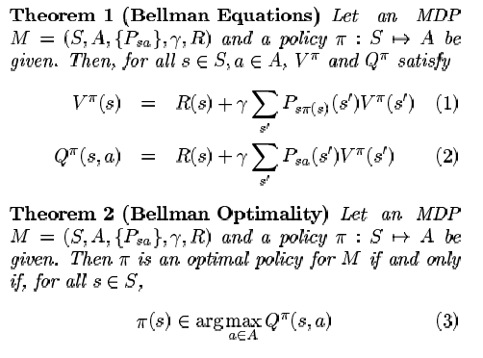
Basic Properties of MDP

Slide 10
Inverse Reinforcement learning
The inverse reinforcement learning problem is to find a reward function that can explain observed behaviour. We are given:
  A finite state space S.
  A set of k actions, A={a₁,...,a_{k}}.
  Transition probabilities {P_{sa}}.
  A discount factor γ and a policy π.
The problem is to find the set of possible reward functions R such that π optimal policy.

Slide 11
The steps IRL in Finite State Space
Find the set of all reward functions for which a given policy is optimal.
The set contains many degenerate solutions.
With a simple heuristic for removing this degeneracy, resulting in a linear programming solution to the IRL problem.

Slide 12
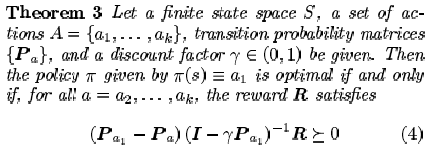
The Solution Set
is necessary and sufficient for π=a₁ to be unique optimal policy.

Slide 13

The problems
R=0 is always a solution .
For most MDP s it also seems likely that there are many choices of R that meet criteria:
How do we decide which one of these many reinforcement functions to choose?

Slide 14

LP Formulation
Linear programming can be used to find a feasible point of the constraints in equation:
Favor solutions that make any single-step deviation from π as costly as possible.

Slide 15
Penalty Terms
Small rewards are “simpler” and preferable. Optionally add to the objective function a weight decay like penalty:
-λ||R||
where λ is an adjustable penalty coefficient that balances between the twin goals of having small reinforcements, and of maximizing.

Slide 16
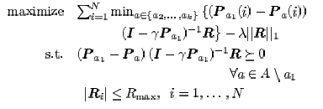
Putting all together
Clearly, this may easily formulated as linear program and solved efficiently.

Slide 17

Linear Function Approximation in Large State Spaces
The reward function is now: R:{Real}^{n} →{Real}
The linear approximation for the reward function:
where φ₁,.., φ_{d} are known basis function mapping S into Reals and the α_{i} are unknown parameters.

Slide 18



Linear Function Approximation in Large State Spaces
Our final linear programming formulation:
where S₀ is the subsamples of states. P is given by p(x)=x if x ≥ 0, p(x)=2x otherwise.

Slide 19
IRL from Sampled Trajectories
In realistic case, the policy π is given only through a set of actual trajectories in state space where transition probabilities (P_{a}) are unknown, instead assume we are able to simulate trajectories. The algorithm:
  For each π ^{k} run the simulation starting S₀.
  Calculate V ^{π} (S₀) for each π ^{k}
  Our objective is to find α_{i} s.t. :
  A new setting α_{i} s, hence a new Reward function.
  Repeat until large number of iterations or R with which we are satisfied.

Slide 20
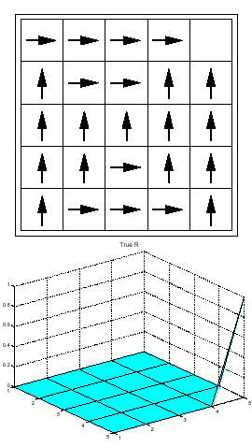
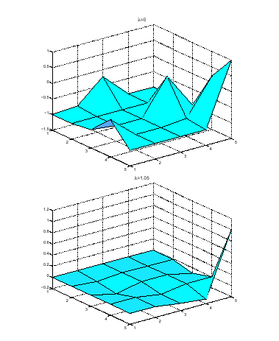
Experiments

